Slide 1
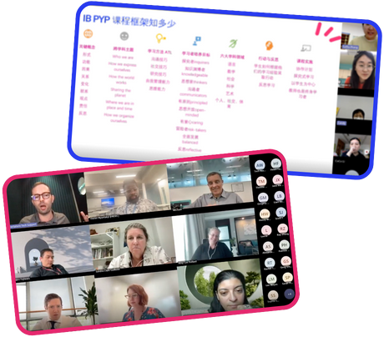
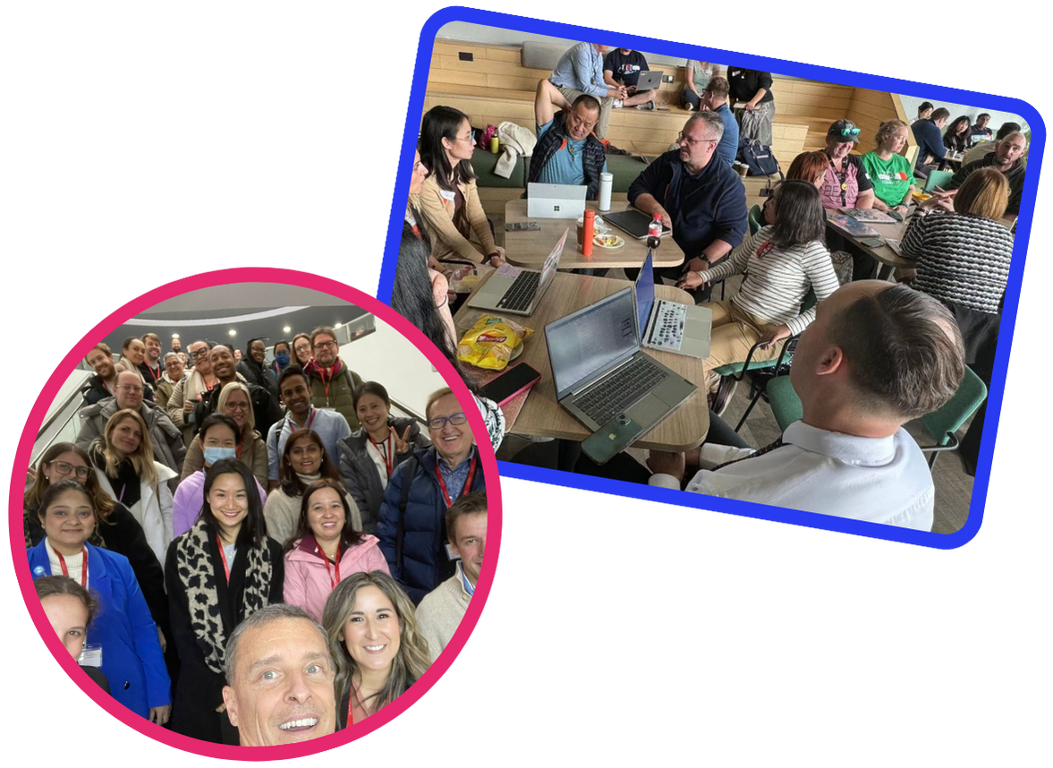
PeerSphere
利用协作社区的力量。
在PeerSphere，小投入，大收获
第二版本
© PeerSphere 2024
Notes:
SLIDE 1: Welcome
Harnessing the Power of Collaborative Communities – Peer Sphere believes that when educators connect, share, and innovate together, the entire education landscape transforms.
This slide deck is a recommended optional resource for School Account Managers (SAMs) to introduce PeerSphere to school staff.
It is designed to support a 60 minute in-school PD session.
The following timings and order of running are suggested and can be adjusted to fit school contexts.
As a large Group: 20 mins – Slides 1 - 13
In small Groups/Teams: 20 mins – Slides 14 onwards
Pairs/Individuals: 20 mins – Slide 18 to get started
See handbook for more detailed outline of a suggested session: https://www.peer-sphere.com/peersphere-handbook-2024-2025/
Note for Facilitator: Tailor slides 4, 9 and 18 with school specific information. In order to facilitate session delivery, you might want to:
Share a digital version of the PowerPoint slides to all staff to enable quick reference to your unique school URL and key information.
Provide copies of the PowerPoint slides printed three to a page with space for notes for each staff member.

Slide 2
我们已加入亚洲最大的国际学校专业学习社群（PLC）
© PeerSphere 2024
Notes:
SLIDE 2: We've joined Asia's largest PLC for international schools
ACTIVITY: Present this slide with the benefits of connecting across schools in PLCs ...
PeerSphere can…
enable each of us, admin, teaching and non-teaching staff, to connect with professionals in similar roles
share about the great work we do
get some new ideas and resources from other schools
extend our professional network in the process

Slide 3
想想你过去曾有过的一次极佳的专业学习体验。那次经历是什么？是什么让它如此出色？
讨论并找出其中的共性。
© PeerSphere 2024
Notes:
SLIDE 3: Discussion Prompt
ACTIVITY: Think of ONE great professional learning experience you have had in the past. What was it and what made it great? Discuss and identify commonalities.
Talk to the person next to you
Identify commonalities about what made the PD great
Be ready to share
Note for Facilitator: Elicit points that have been heard in discussions. These will likely include some of the points below and will connect to intended professional learning experiences with PeerSphere. This will help staff buy-in.
Great professional learning is content-focused, has practical take-aways, is engaging, is fun, involves learning with others, is led by skilled facilitators, involves rich discussions, is ongoing, is supportive, has direct impact on practice…

Slide 4
课程概览
目标 🎯
了解什么是PeerSphere，以及它对我们的重要性
开始探索PeerSphere如何为我们的学校、团队和我们每个人带来价值
能够连接/设置个人账户
成果 📈
我们每个人将会……
确定一个想要加入的PeerSphere社区
掌握加入的方法
开始与所选社区建立联系
© PeerSphere 2024
Notes:
SLIDE 4: Session Aims and Outcomes
ACTIVITY: Present this slide. Share the session aims, outcomes alongside order of running/session timings (adjust according to school context):
As a Large Group introduction: 20 mins – Understand what is PeerSphere and why it matters for our school
In Small Groups/Teams: 20 mins – Explore how PeerSphere can add value to our school, our teams and each of us as individuals
Pairs/Individuals: 20 mins – Identify the community that excites you and have the know how to join

Slide 5
PeerSphere
我们为国际教育专业人士打造蓬勃发展的社区，协作解决与他们角色相关的重要问题。
蓬勃发展的社区
专业主持人
战略性学校合作
协作探究
© PeerSphere 2024
Notes:
SLIDE 5: PeerSphere
ACTIVITY: Present this slide with any or all of the key messages below.
PeerSphere …
Builds thriving communities for international education professionals who collaborate to solve meaningful problems related to their role.
Harnesses the power of collaborative communities to address the unique challenges faced by international school educators and administrators.
Supports professionals to not only develop but flourish through close collaboration, strategic school partnerships and expert community hosts.

Slide 6
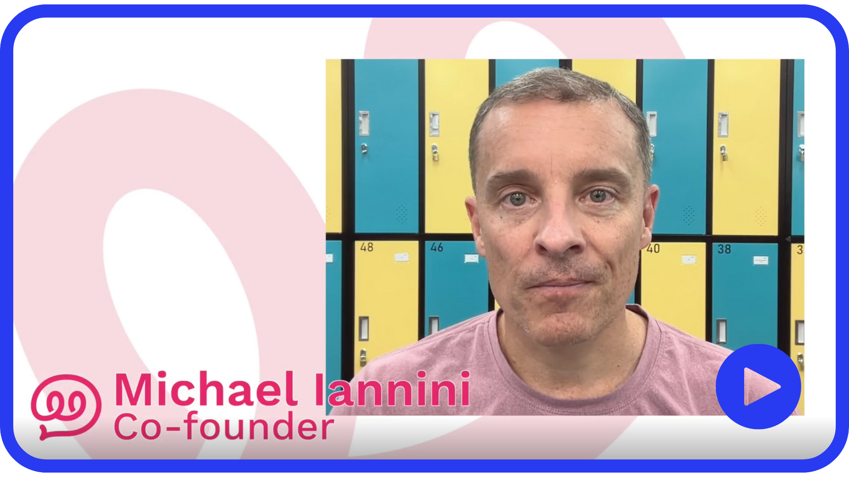
为什么 PeerSphere?
点击聆听 PeerSphere 联合创始人 Michael Iannini 的分享
© PeerSphere 2024
Notes:
SLIDE 6: Why PeerSphere?
ACTIVITY: Click on the link to hear about 'Why PeerSphere?' (Video Length: 2:00)
Co-Founders Michael Iannini and Ewen Bailey are seasoned professionals with a combined experience of 30 years in the international education sector. Their paths crossed in China in 2015, igniting a shared commitment to enhance the professional growth of education professionals.

Slide 7
为什么PeerSphere?
学习与联结
国际学校领导、教学和非教学员工都面临着共同的问题……
而成为与担任类似角色的专业人士组成的社区成员，可以帮助解决这些问题
痛点…
解方…
孤立工作
围绕共同的专业问题开展协作
感到孤立
在面对类似挑战的社区中，感受到被关注和倾听
渴望获得正确的见解
学习符合您需求且及时相关的主题
© PeerSphere 2024
Notes:
SLIDE 7: Why PeerSphere? International school leaders, teaching and non-teaching staff face common problems – and being a member of a community with professionals in similar roles can help to solve them.
ACTIVITY: Present this slide. Share the problems and solutions.

Slide 8
为什么PeerSphere对您和您的实践可能有用？
想想您过去曾面临或即将在今年面临的一个实践问题。加入一个跨校的专业学习社群（PLC）对您、您的团队或我们的学校有哪些益处？
© PeerSphere 2024
Notes:
SLIDE 8: Discussion Prompt
ACTIVITY: Why might PeerSphere be useful to you and your practice? Think of ONE problem of practice you have faced in the past/might face this coming year. How might joining a cross school PLC be beneficial to you/your team/our school?
Talk to the person next to you
Identify benefits to you, or/& your team, or/& our school
Be ready to share
Note for Facilitator: Walk around, listen and share some of the points you have heard with the whole group. This can help staff buy-in.
Further problems and solutions might include:
Short on quality resources – share and receive great ideas, resources, and practices
Feeling like they're the only one – better understand your role relative to others

Slide 9
强化我们的学校使命
通过PeerSphere的学校通行证
学校使命/愿景/价值观
专业学习的认证标准
学校、团队和个人层面的发展目标
学校
团队
个人
在 学校 层面
为所有员工提供宝贵的能力建设机会
释放我们学校中已经存在的潜在能力。
在 团队 层面
培养持续专业学习，成为高效团队的习惯
利用有力的实施实践，确保成功的成果
在 个人 层面
获得满足多样化需求的个性化专业学习途径
与战略举措保持一致的学习
在您的专业学习中迈出重要的一步。
© PeerSphere 2024
Notes:
SLIDE 9: Strengthening our School Mission
ACTIVITY: Present this slide (adjust according to school context).
PeerSphere can support our mission at the school wide level, team level and individual level …
PeerSphere provides ...
Job embedded professional learning – this is an invaluable opportunity for us all , leaders at all levels, teachers and non-teaching staff, to learn and grow with professionals in similar roles as ourselves for direct impact on our practice
Working together – we have a good opportunity to strengthen our professional learning habits as teams – dept. team, grade-level team, divisional teams – as well as working towards achieving school wide collective goals
Inclusive professional learning – each of us can join ONE community of our choice to impact individual practice – you CAN join more communities if you wish!
Note for Facilitator: Adjust this slide according to your school context. You might want to include information or invite thinking in relation to ...
School mission/vision/values/logo …
Accreditation standards around professional learning
Development goals at school, team and individual level

Slide 10
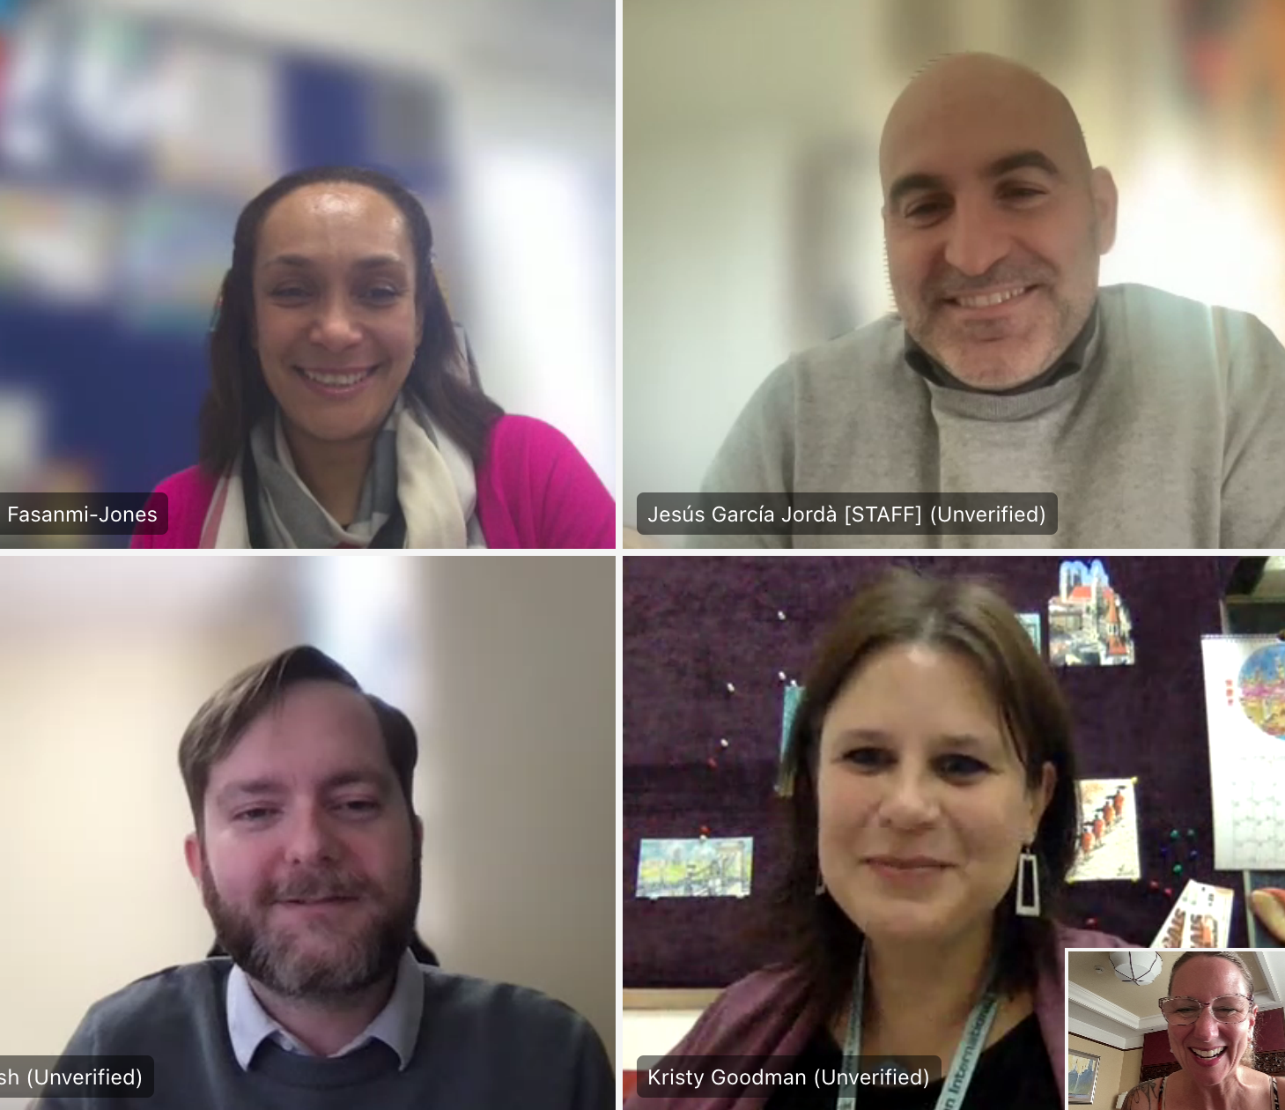
我们的影响
92%
的受访者表示同意或非常同意：
“我从同事那里学到了对我的工作产生积极影响的东西。”
的受访者表示同意或非常同意：
“在过去的一年中与我的同事互动带来了宝贵的学习体验。”
96%
同伴辅导项目
“在我准备明年担任领导角色时，辅导项目就像一把指南针，引领我穿越即将到来的角色中的种种复杂性。”
—— 来自“规划专业发展”社区的学员
“在我们提出一系列澄清性问题后，我们就可以与[学员]一起进行创意交流，并基于我们曾在多所学校工作的经验分享。”
—— 来自“全球公民”社区的辅导员
下载影响报告
© PeerSphere 2024
Notes:
SLIDE 10: Our Impact
ACTIVITY: Share impact highlights.
Note for Facilitator: Invite staff to download and view the impact report during individual/paired work time towards the end of the session.

Slide 11
我们的影响
PeerSphere社区为学校和教育工作者的专业学习带来了极大的价值。在学校致力于在专业学习中更具包容性，并为那些传统上资源较少的员工寻找机会的时刻……我们期待社区扩展，提供更多机会给支持和非教学岗位的员工。
这是一个让我们与其他图书馆员交流的绝佳机会，了解他们在与学生沟通、推广阅读兴趣以及如何将课堂阅读与图书馆结合等方面的经验。确实，他们的一些精彩想法启发了我，并让我在图书馆实施了一些措施。
成为PeerSphere的一员对我们学校来说是一个胜利。
这些社区让我们有机会向他人学习并展示我们自己的实践……我们计划在明年及以后继续保持联系。
Jocelyn Chen
Shenzhen College of International Education
Kasson Bratton
Nanjing International School
Stephen Taylor
Western Academy of Beijing
下载影响报告 ​
© PeerSphere 2024
Notes:
SLIDE 11: Our Impact
ACTIVITY: Invite staff to read testimonials from some of PeerSphere's current partner schools.
Stephen Taylor on inclusive professional learning – equitable and accessible to all staff
Jocelyn Chen on how shared ideas impacted change in practice in her library
Kasson Bratton as year on year continued school partner
Note for Facilitator: Invite staff to download and view the impact report during individual/paired work time towards the end of the session.

Slide 12
如何运作？
点击观看，了解您与我们同行的更多内容
© PeerSphere 2024
Notes:
SLIDE 12: How it works?
ACTIVITY: Click on the link to watch about how PeerSphere works. (Video Length: 2:00)
Listen to Michael Iannini talk about the Core Journey with PeerSphere.

Slide 13
团队与小组
探索PeerSphere社区信息
（第14页及之后的幻灯片）
2. 讨论您想加入哪个社区
3. 使用注册链接，迈出连接所选社区的第一步
© PeerSphere 2024
Notes:
SLIDE 13: Instructions for Teams and Small Groups
ACTIVITY: The large group can now split up in a two-part next step. Explain that staff will:
1. Work in smaller groups and teams (20 mins):
Explore slide 14 onwards to learn about how PeerSphere works
Ask questions and have conversations about which community you’d like to join
2. Spend time individually or in pairs (20 mins):
Use the sign up URL on slide 18.
Start getting connected with a chosen community.
Have a conversation with a colleague to help make the most appropriate choice.
Note for Facilitator: Before going into small groups and teams, invite thinking about ways to get the most out of PeerSphere ...
School leadership - Consideration of priority communities that can best support school development goals, invite volunteers and allocate to communities.
Teams - Discuss and decide which communities individuals can each join to benefit dept/team collective work.
Teams - Join communities in dyads to support each other bring the learning back into the school.
Individuals – Might want to discuss with appraisers/reviewers to connect a PeerSphere community with individual professional growth processes
Other ideas...?

Slide 14
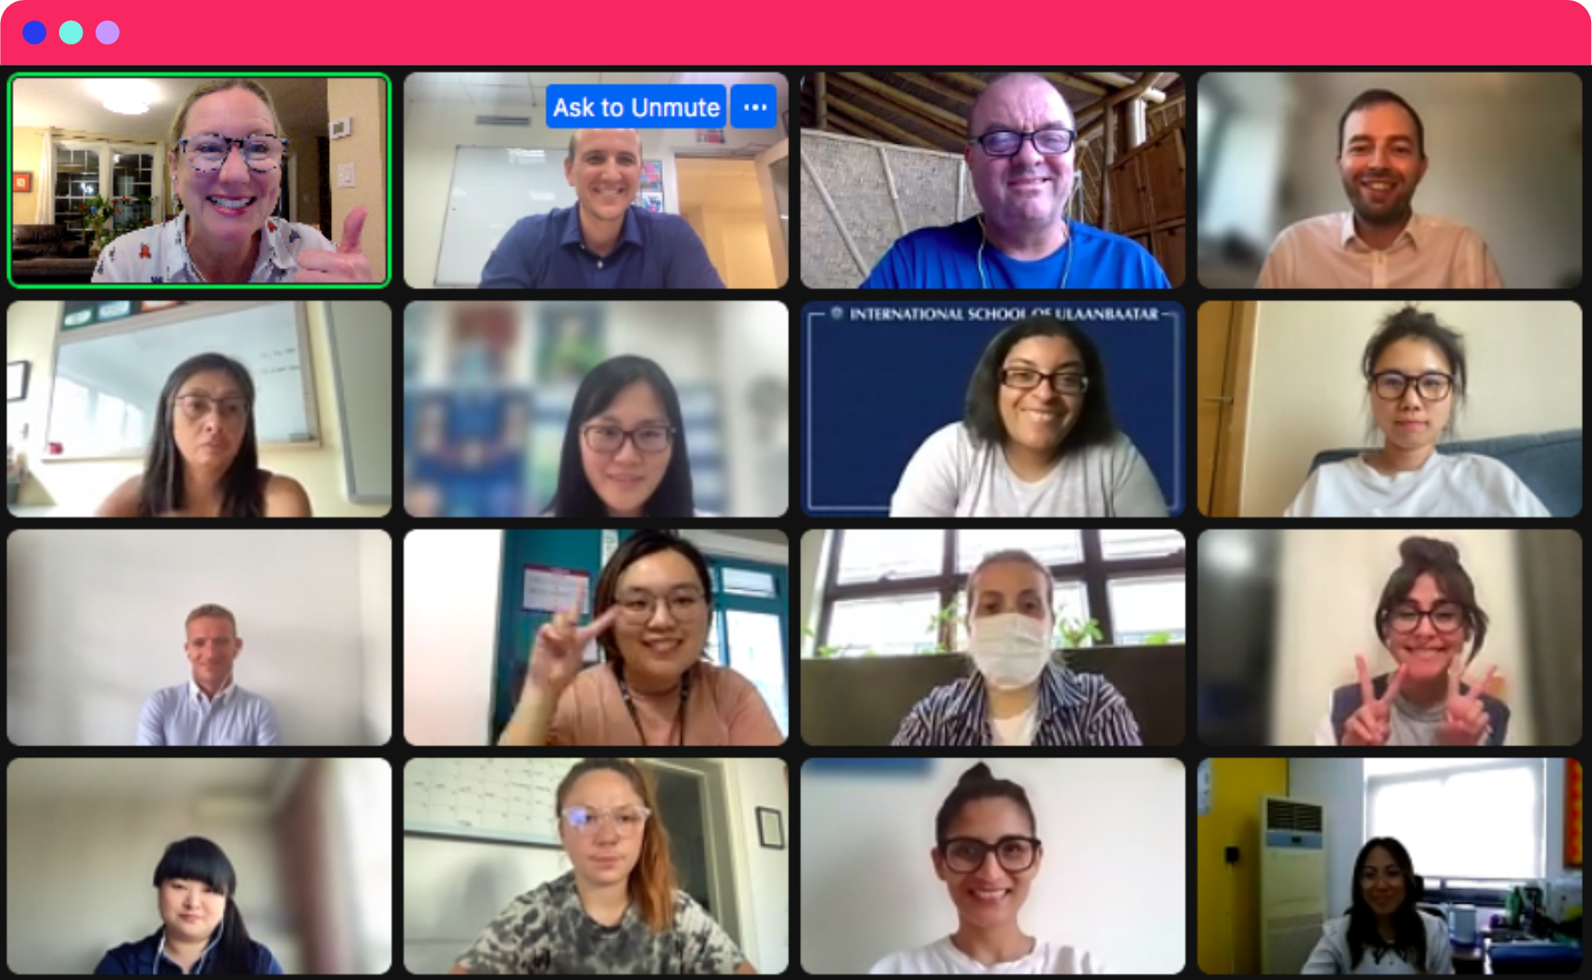
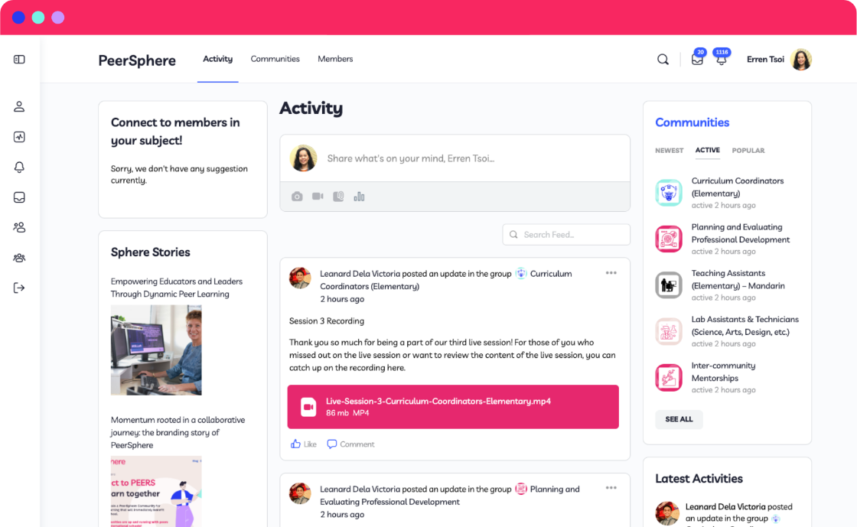
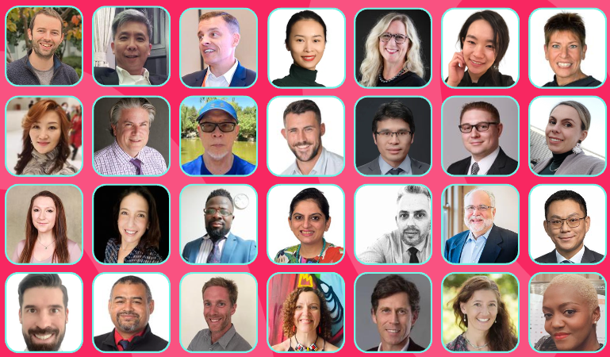
如何运作？
连接与学习的社区……
60多个专业主持的社区
专业且经验丰富的主持人
整个学年将举办4次90分钟的虚拟直播课程
+
点击此处，探索所有社区。
© PeerSphere 2024
Notes:
SLIDE 14: How it works
ACTIVITY: Click on the slide link to explore all the Communities.
The PeerSphere journey …
60+ Communities to choose from – unlimited access for different roles and themes. Example of Middle Leader Commnity = New Middle Leader Community
Regular Virtual Meet-Ups – Four 90-minute live sessions hosted by experts throughout the school year
Free Access to in-person Events – regular in-person topical Peer-to-Peer and hybrid bilingual conferences for various job roles

Slide 15
与我们的同行旅程
3. 学习与成长
直播课程2-3
向他人学习并分享您的专业知识
1. 签到……
激活
查看您的社区中心，自我介绍
4. 庆祝
直播课程4
分享您的成功故事，塑造社区的未来
2. 连接与参与
直播课程1
与您的同伴见面，表达您的学习方式和内容
© PeerSphere 2024
点击此处了解更多
Notes:
SLIDE 15: Your Journey with Us
ACTIVITY: Click on the slide link to find out more about the journey.
Your Core Journey with PeerSphere has 4 stages:
1. Check-in…Activation, check out your community hub, introduce yourself
2. Connect & Engage … Live session 1 Meet your peers & say how and what you want to learn
3. Learn & Grow … Live session 2-3 Learn from others and share your expertise
4. Celebrate … Live session 4 Share your stories of success and shape the future of your community

Slide 16
点击观看您的会员资格还包含哪些内容
© PeerSphere 2024
Notes:
SLIDE 16: There's so much more
ACTIVITY: Click on the link to watch and learn what else is included in your membership. Don't miss out! (Video Length: 2:04)

Slide 17
还有更多精彩内容……
提供更深入的机会……
同伴辅导
与另一位PeerSphere成员结对，运用我们的辅导模式助您成长
同伴交流活动
每月在中国和东亚各城市举办的线下活动
社区间网络研讨会与交流活动
聆听专家对重要话题的分享，与我们所有社区的同伴建立联系
会议
免费虚拟参加助教和非教学员工会议
© PeerSphere 2024
Notes:
SLIDE 17: There's so much more
ACTIVITY: Read more about further opportunities ...
Peer Coaching: November to May (more info: https://www.peer-sphere.com/peer-coaching/)
Peer to Peer Events – monthly in cities across China and East Asia (more info: https://www.peer-sphere.com/peer-to-peer-events/)
Conferences – free virtual access to conferences for Teaching Assistants and Non-Teaching Staff (more info: https://www.peer-sphere.com/hybrid-conferences/)
Intercommunity networking events & webinars – expert input and peer discussions

Slide 18
开始吧！
转发包含学校会员激活链接的邮件给员工
链接： 会员手册
签到截止日期：10月10日星期三
© PeerSphere 2024
Notes:
SLIDE 18: Get Started!
ACTIVITY:
Use the link to access the members handbook.
Use your school's unique sign-in URL to get connected in PeerSphere BEFORE (date).
Reflect and share:
What excites you about the journey ahead with Peer Sphere? Two things.
What challenge might you forsee with the journey ahead? What can you do in advance to overcome this? One thing.
What will you do as a result of the PeerSphere learning journey? Make one commitment.
Note for Facilitator: Add the date by which you would like all your school staff to have signed in to their PeerSphere community.

Slide 19
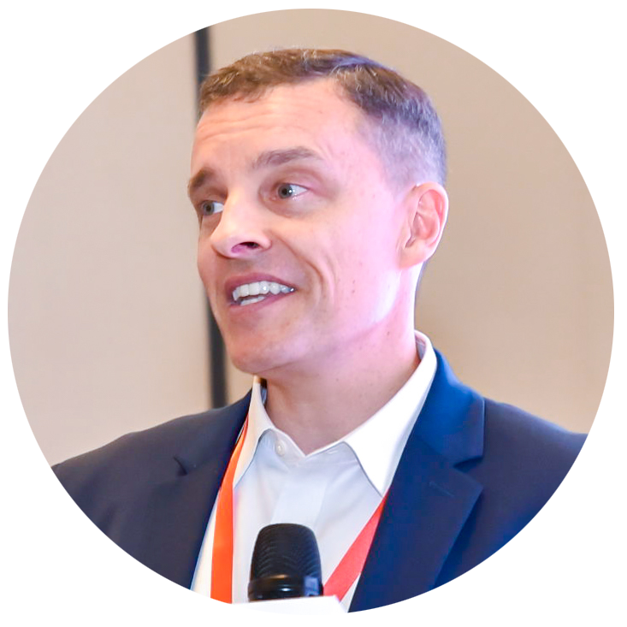
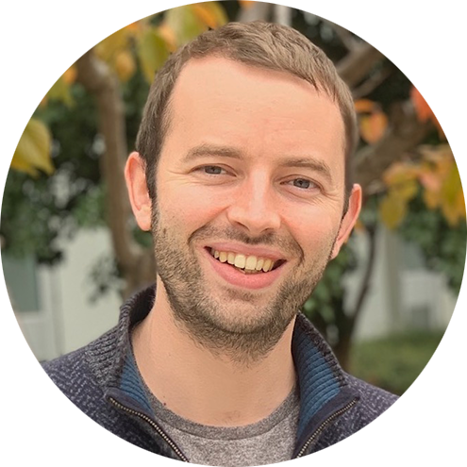
关于我们
Michael Iannini
ACAMIS 领导力发展导师
Search Associates 中国区人力资源专业发展协调员
国际学校联盟（CIS）顾问
专业领域：评估与专业发展、领导力培训、学校治理与战略规划
Ewen Bailey
PD Academia 教育顾问
专业发展与学习专家
拥有丰富国际教育经验的领导者，致力于帮助教师和领导者建立注重持续改进的坚韧协作团队
了解更多
© PeerSphere 2024
Notes:
SLIDE 19: About Us
ACTIVITY: Click on the link to find out more about PeerSphere Co-Founders, Michael Iannini and Ewen Bailey.

Slide 20
同伴学习研究
阅读有关同伴学习的力量
研究如何显示同伴学习是有效的专业发展，请查看 (PeerSphere)
同伴学习的热潮，请查看 (PeerSphere)
创建更强大、更具协作性的教师团队的4个步骤，请查看 (ASCD)
同伴学习的力量：对专业人士来说经济实惠、可持续且充满活力的方法，请查看 (Forbes)
重新构建教师协作，请查看 (教育发展信托)
查看我们博客上的更多故事
© PeerSphere 2024
Notes:
SLIDE 20: About Us
ACTIVITY: Click on the links to read more about the power of peer learning.

Slide 21
谢谢！
© PeerSphere 2024
Notes:
SLIDE 21: Thank you!

